Slide 1
Lab 2

Slide 2
Understanding Current Apps
When designing a current application to make it better, it's important to examine:
How it is currently used
What are the main features
What type of tasks can be done on the app
How these features help perform tasks
How do people perform these tasks (e.g., how it is supposed to be used vs how it actually used)
And how uses it (types of users)
Afterwards, you can start to to look at:
What is good and what isn't so good (e.g., Can something be improved?)
Are there missing features?
Then you can start to design improvements to existing features and imagine new features… (then evaluate and start again…)

Slide 3
Today - we're going to start looking at:
When designing a current application to make it better, it's important to examine:
How it is currently used
What are the main features
What type of tasks can be done on the app
How these features help perform tasks
How do people perform these tasks (e.g., how it is supposed to be used vs how it actually used)
And then you can start to to look at:
What is good and what isn't so good (e.g., Can something be improved?)
Are there missing features?
Then you can start to design improvements to existing features and imagine new features… (then evaluate and start again…)

Slide 4
Lab 2 Instructions
On Brightspace, you'll find a template for this Lab due at the end of the lab (11:00pm tonight)
Instructions:
First find two applications for your device that fit your topic. Pick common apps (e.g., if you were looking at map apps, you probably look at Google Maps and maybe Apple Maps). Examine both applications in detail. Try out all the features of each app with your team. Then decide on one app to focus on.
Discuss and figure out the variety of tasks) and which features would support these tasks.
The number of features/tasks may be quite extensive so you should focus on useful or unique ones (four total) that as a team you think are the most important.
Then develop 4 well-written and specific tasks that you could ask a user to do on the application that would require them to use at least two of the features of the application.

Slide 5
Example – Google Maps
Potential Tasks:
find a route between two points (features: search for locations, see different directions on the map, see time via walking, bus, driving, etc.)
find route between two points that avoids traffic (features: …)
find points of interest near me (features: …)
A potential task for task 1 that uses at least two of the features mentioned:
"You need to get from your apartment on 6567 Quinpool Street in Halifax to the Halifax Airport for flight home for the holidays. Use google maps on your mobile phone to find the fastest route if you were to drive there and the fastest route if you needed to take the bus to the airport."
Note: the task needs to be very specific so that you can compare how different people use the application to do the same task and it gives the user a notion of what type of features they can use on the app (and app) to do the task (without telling exactly how to do it).

Slide 6
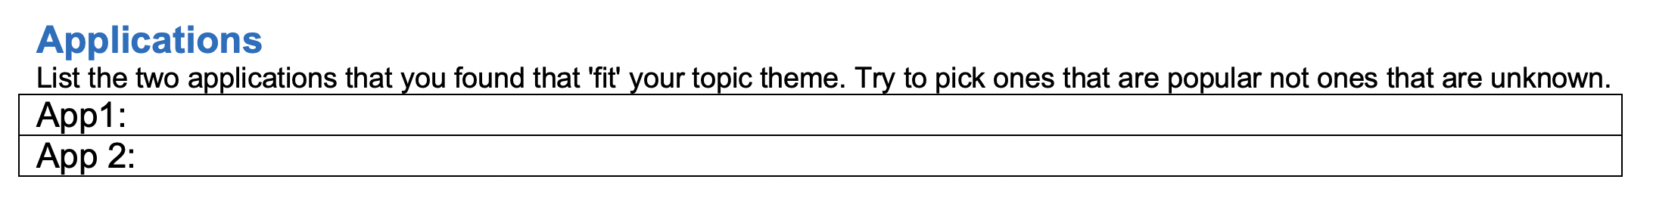
Decide on two applications that fit your theme (pick well known/popular ones)

Slide 7
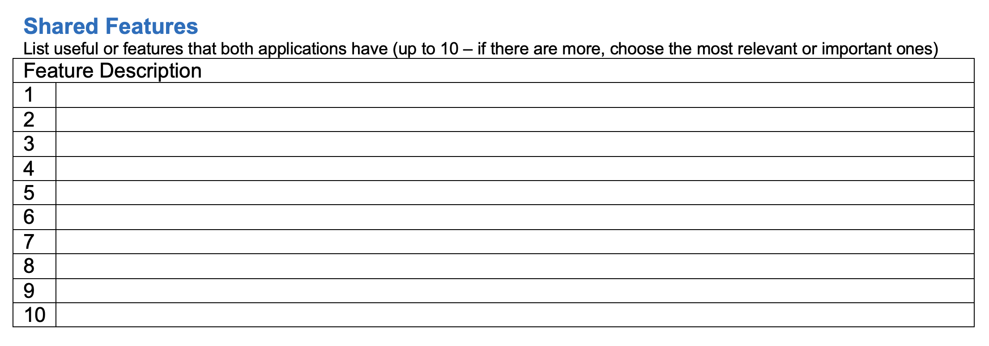
Try both apps out and find up 7-10 shared features (both apps have a feature that do the same thing even if it looks different)
Also, if there are more than 10 features, then choose the most relevant ones or important ones.
You should have 7-10 shared features

Slide 8
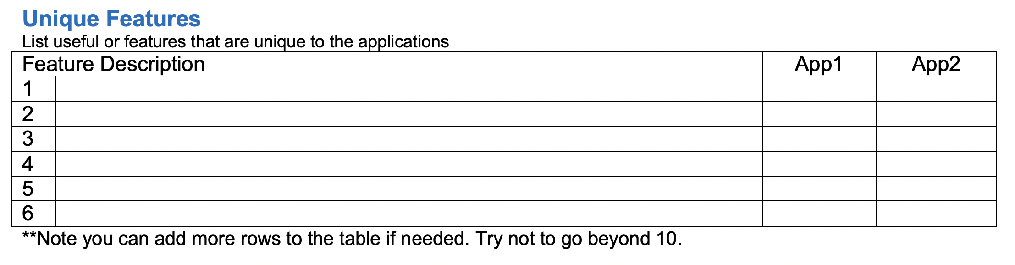
List unique features ~5-10 (ones that only one of the two apps have)
You can add up to 10 rows for this table.
Make sure to indicate which app the features applies.

Slide 9
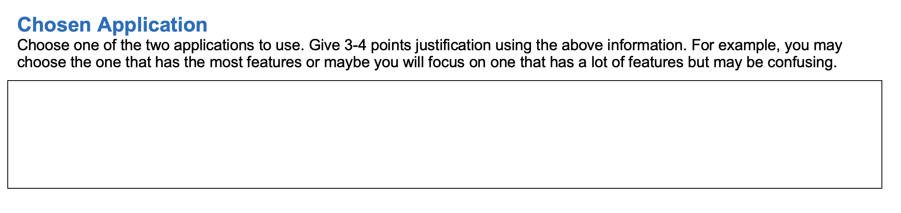
Tell us which application you have chosen to focus on with a short justification (e.g., it may be the one with the most unique features although some may be confusing – what is confusing about them)

Slide 10
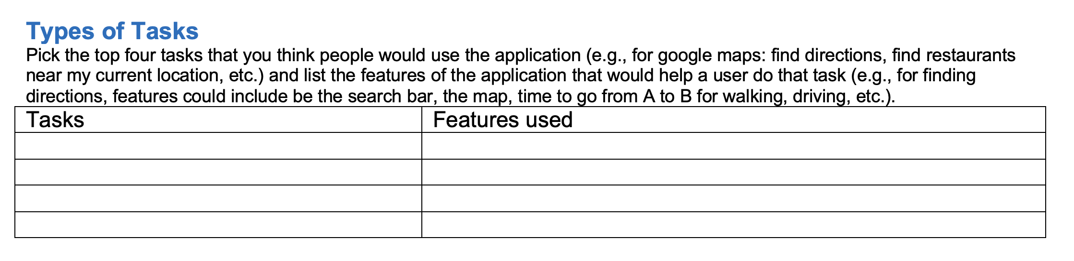
Determine the top four common tasks that people would use the application for and the current features that would support these tasks:
For example, if you were looking at google maps and the task was to find points of interest near me the features may include using the search feature, applying layers)

Slide 11
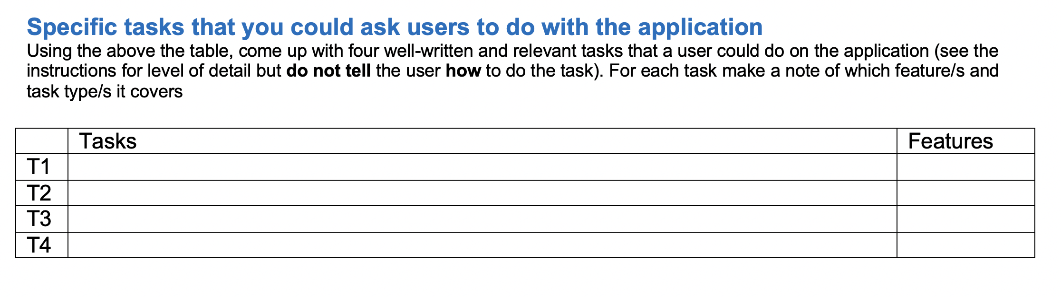
Come up with Specific Tasks
Come up with very specific tasks that you could ask a user to do that would allow them to do an actual task and potentially use the different features that you identified to see how they would do the task.
For example: to find out how a user would find directions in google maps
"You need to get from your apartment on 6567 Quinpool Street in Halifax to the Halifax Airport for flight home for the holidays. Use google maps on your mobile phone to find the fastest route if you were to drive there and the fastest route if you needed to take the bus to the airport."
Note: this task is very specific so that you can compare how different people use the application to do the same task and it gives the user a notion of what type of features a user may use (or not). It does not tell the user how to do the task.

